Slide 1
CISC3003 Project Individual Part
Chan Hin Ieong DC226696

Slide 2
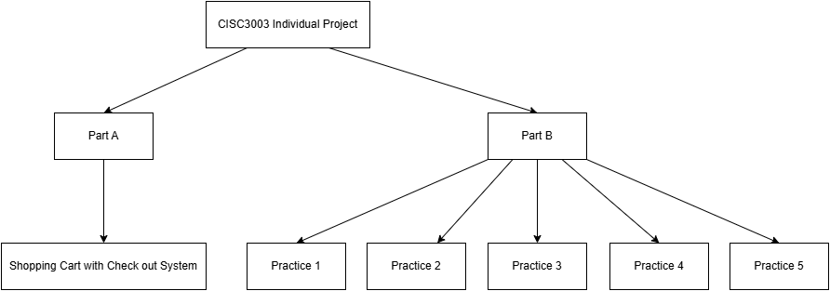
Project Structure

Slide 3
01
Individual Part A
Shopping Cart with Checkout System

Slide 4
Shopping System
Product
View
Cart
Checkout
Orders
Add product info
View all products
Add products to cart
Fill billing details
Record placed orders

Slide 5
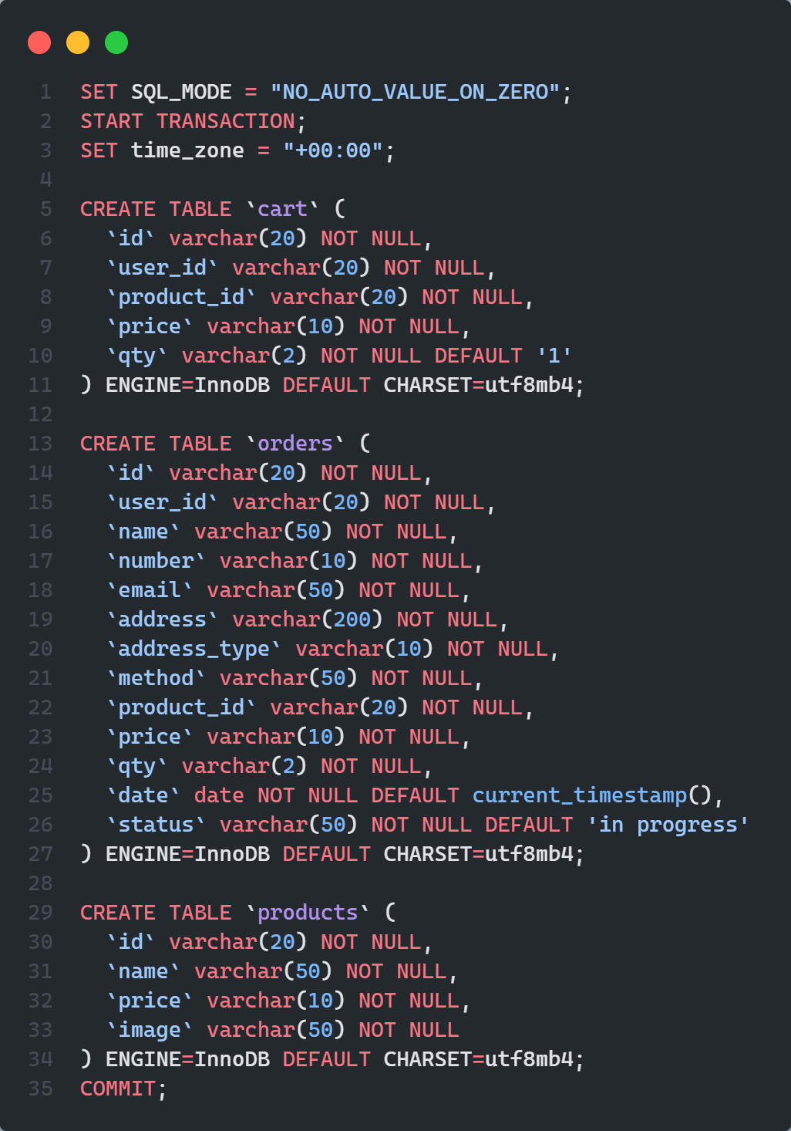
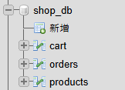
Database Schema

Slide 6
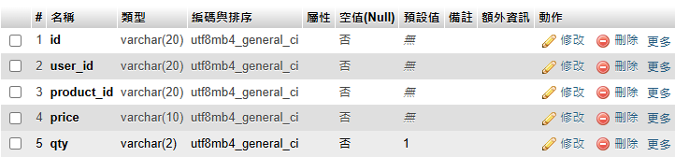
Database Schema
cart

Slide 7
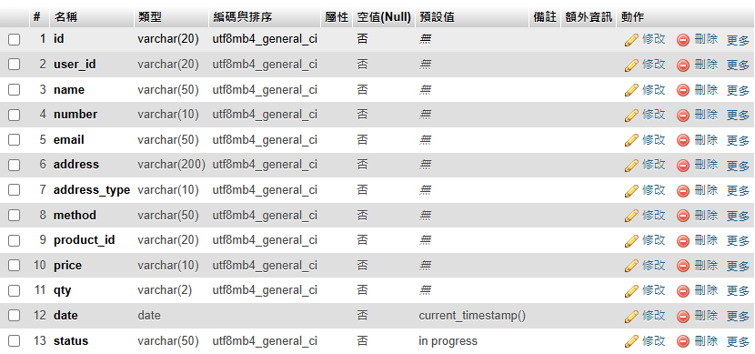
Database Schema
orders

Slide 8
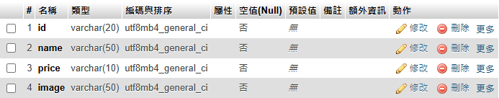
Database Schema
products

Slide 9
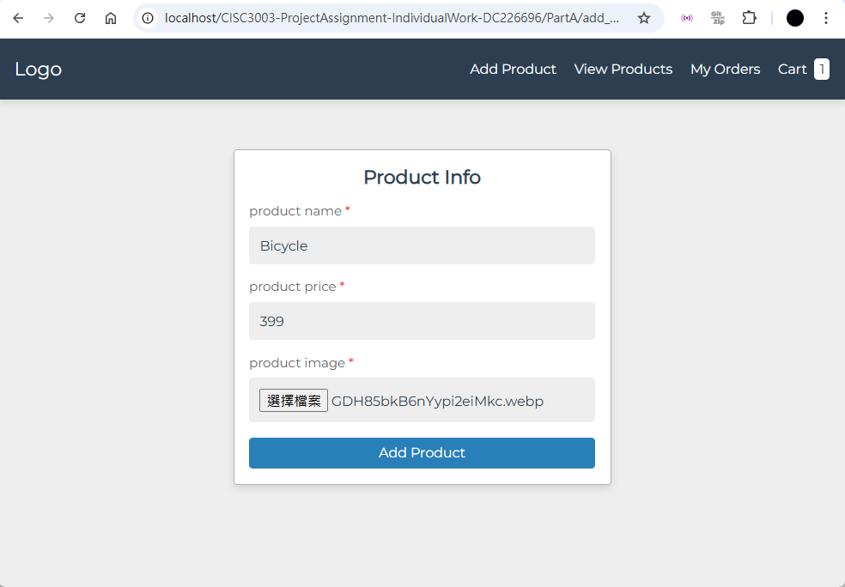
Add Product Info

Slide 10
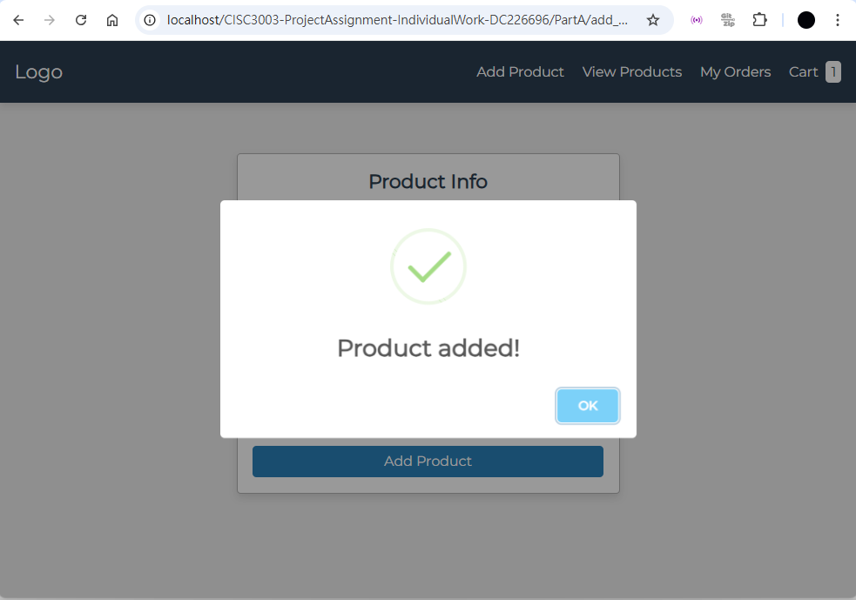
Add Product Info

Slide 11
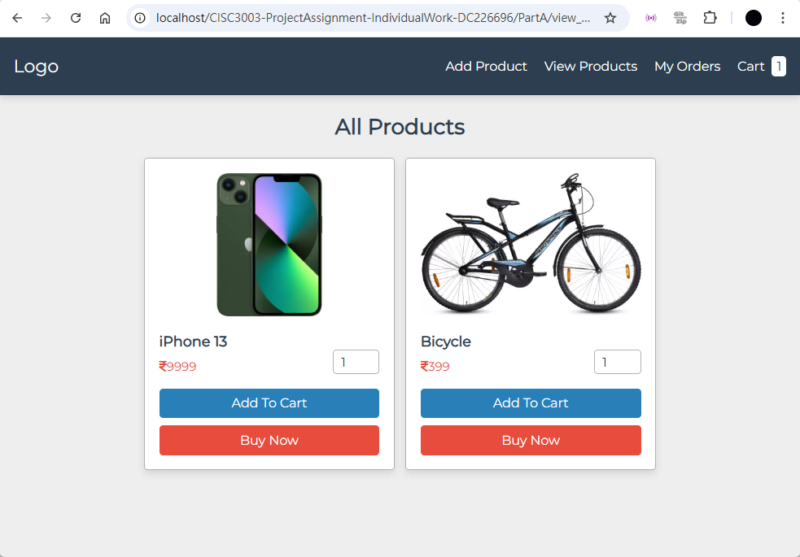
View Products

Slide 12
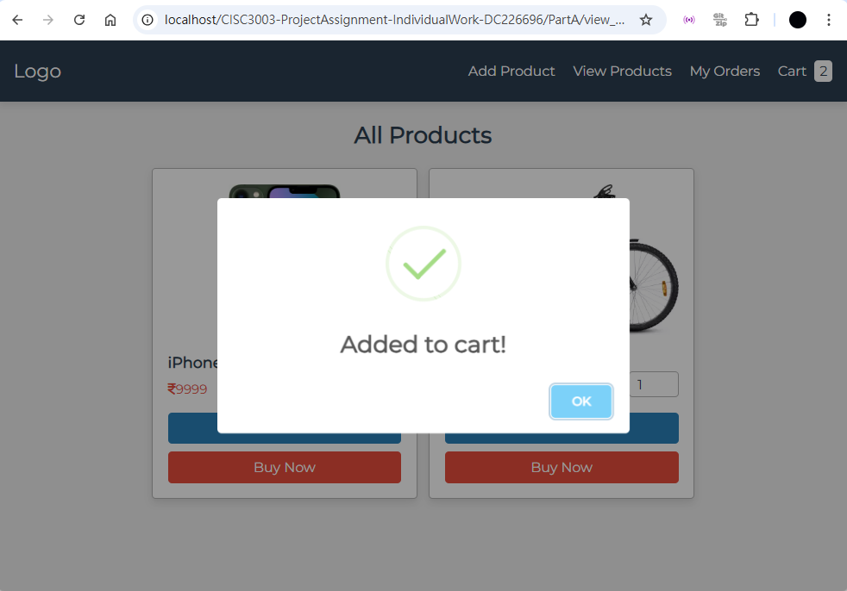
Add to Cart

Slide 13
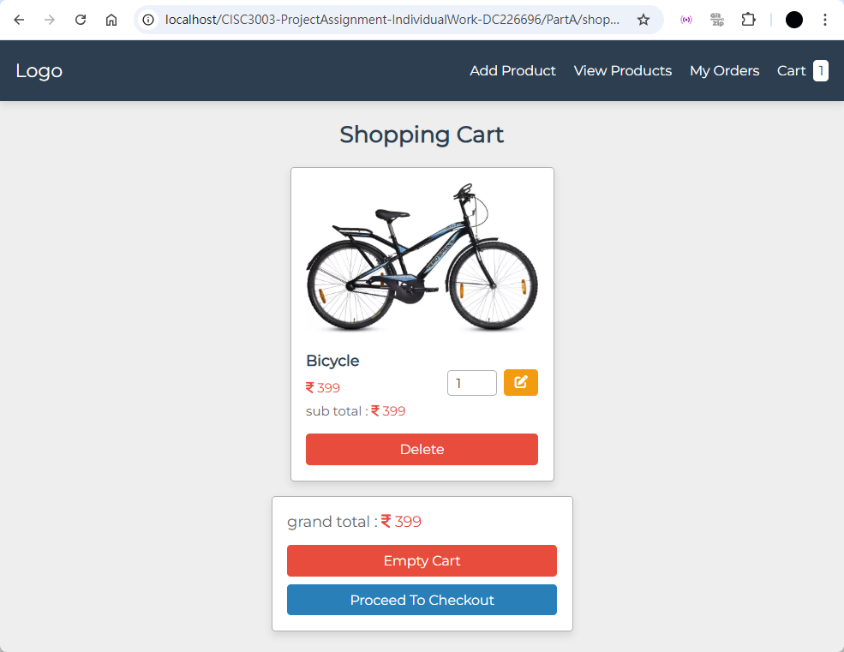
Product in Cart

Slide 14
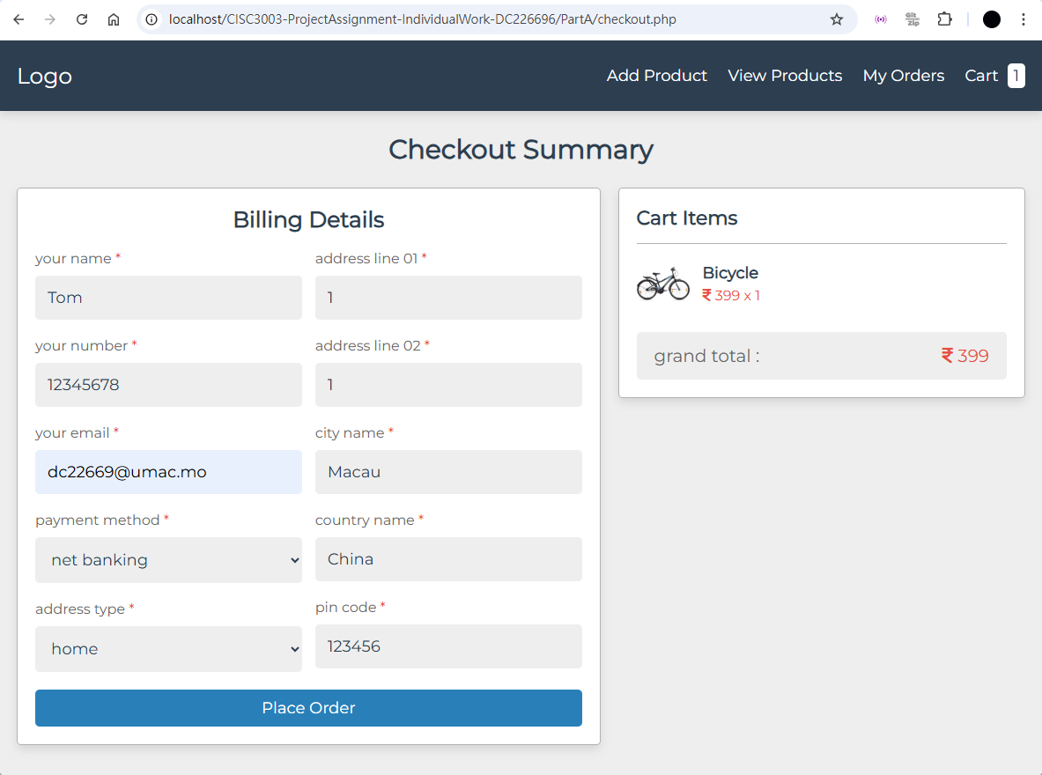
Checkout Billing Detail

Slide 15
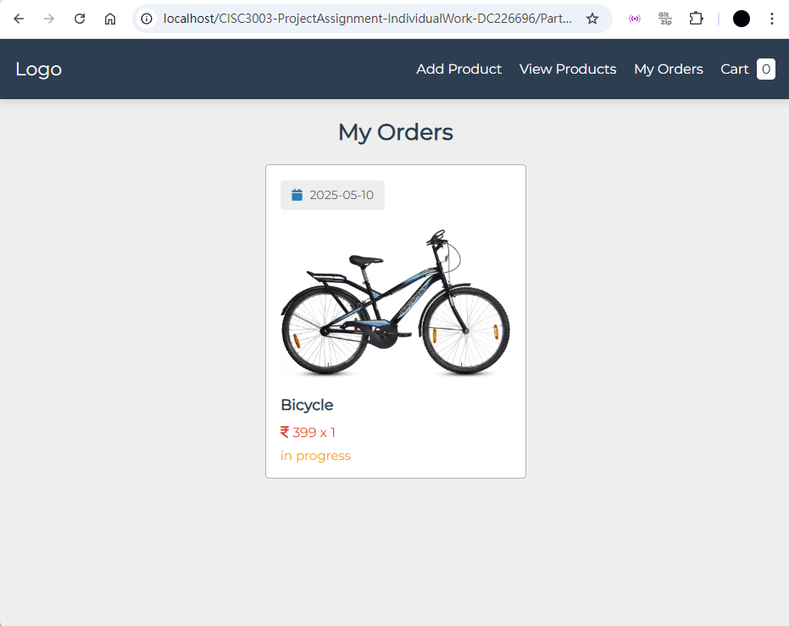
View Orders

Slide 16
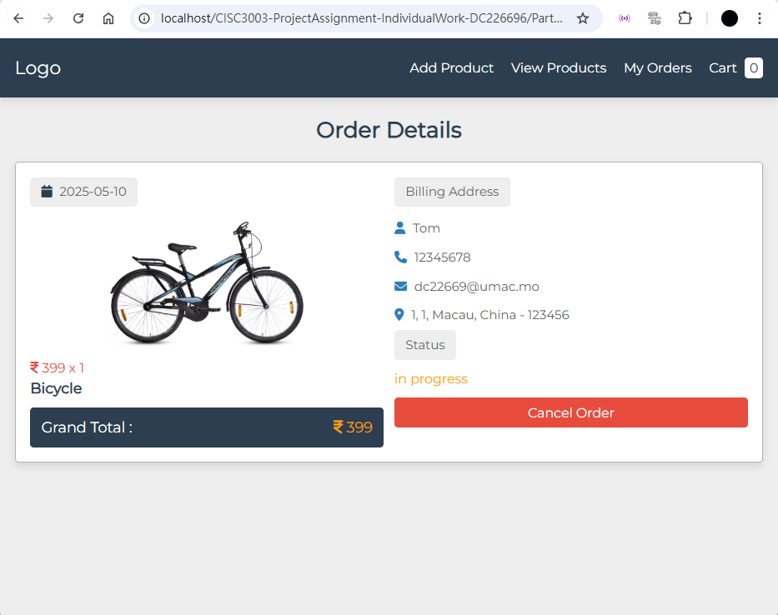
Order Details

Slide 17
02
Individual Part B
5 Practices by Dani Krossing

Slide 18
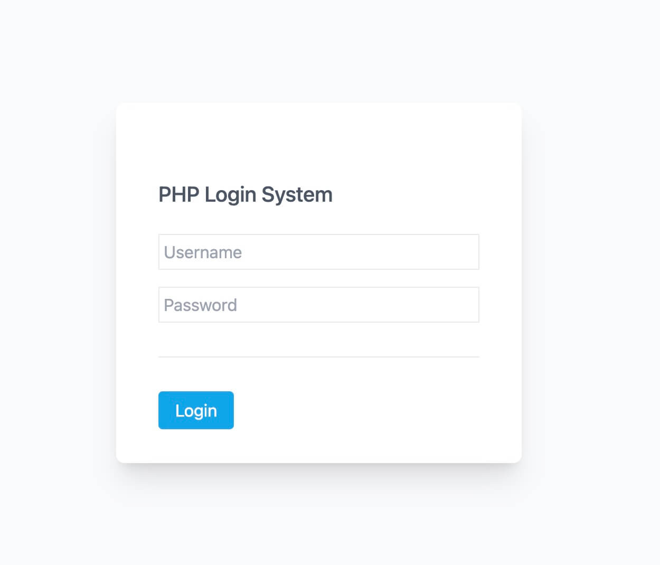
Login System
Five practices mainly focused on the implementation of sign up and log in system.

Slide 19
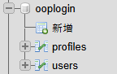
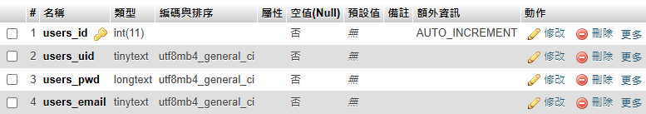
Practice 1 – Database
ooplogin
– users

Slide 20
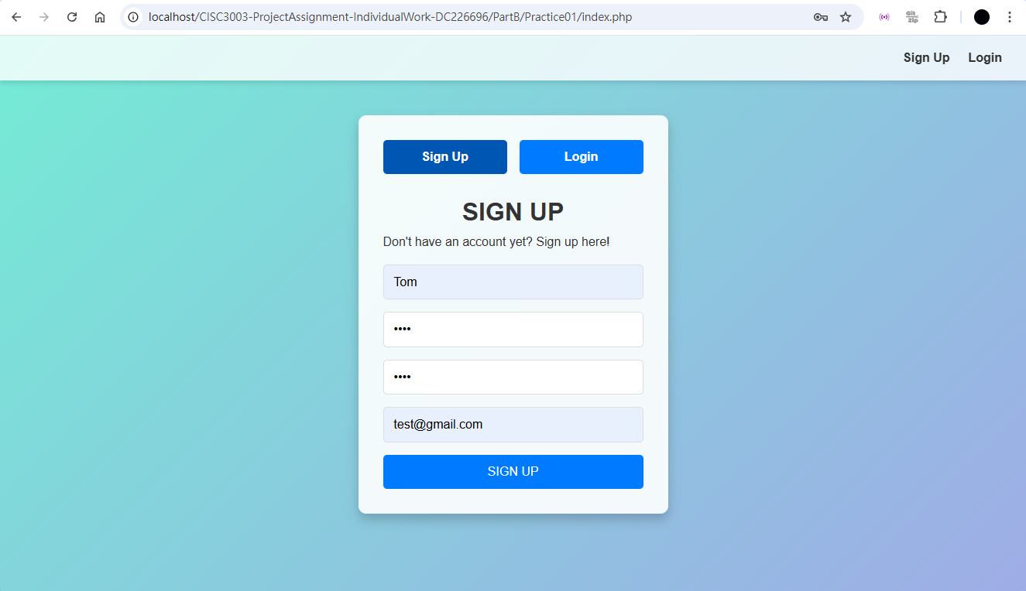
Practice 1 – Sign Up

Slide 21
Practice 1 – Sign Up

Slide 22
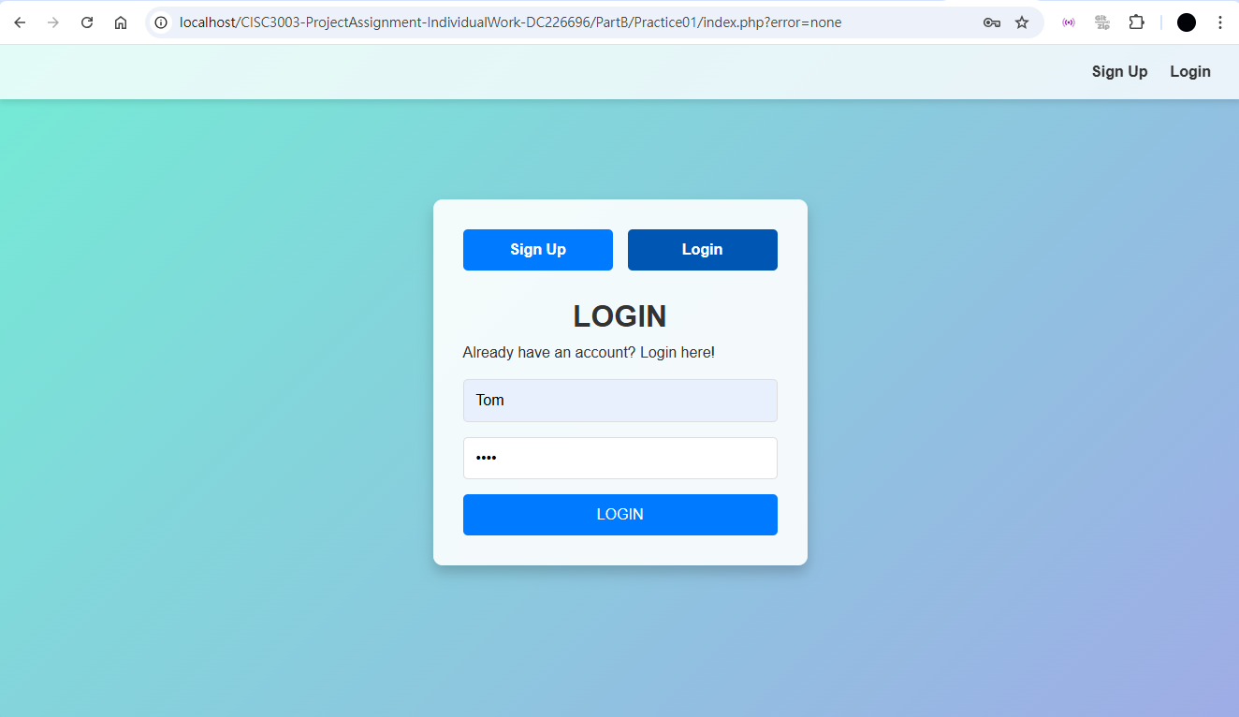
Practice 1 – Login

Slide 23
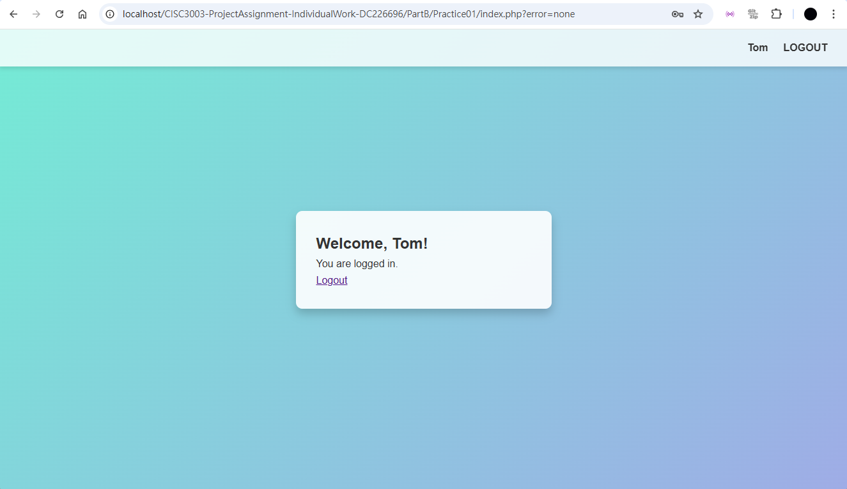
Practice 1 – Logged In

Slide 24
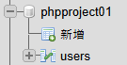
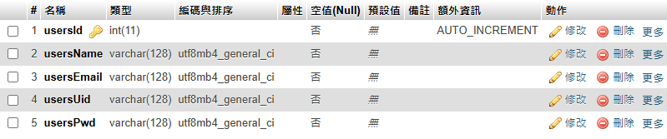
Practice 2 – Database

Slide 25
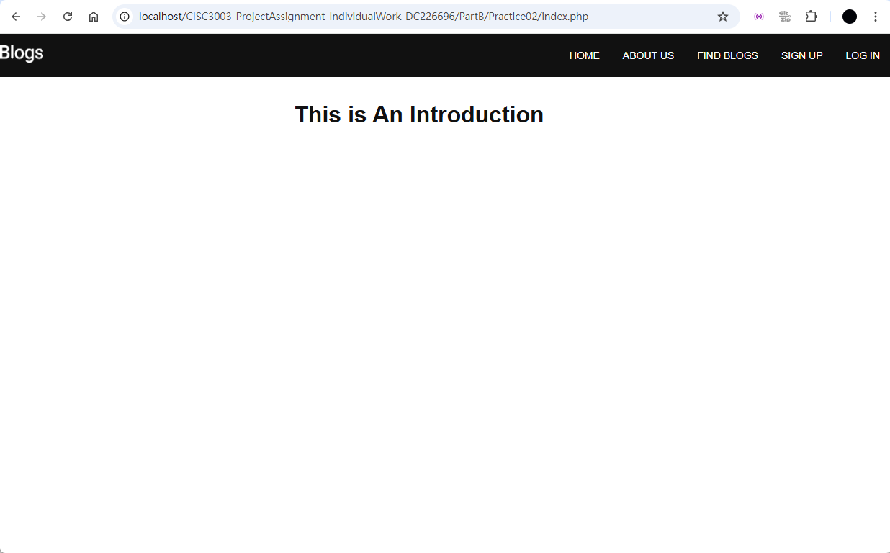
Practice 2 – Home

Slide 26
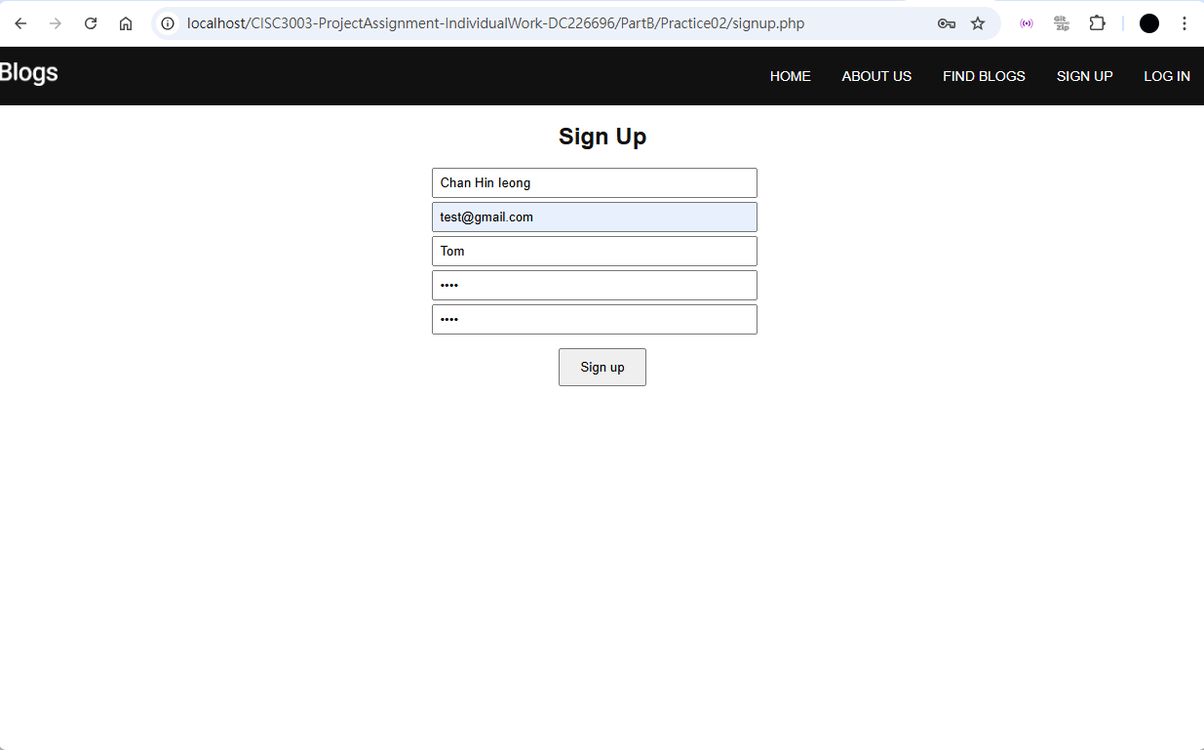
Practice 2 – Sign Up

Slide 27
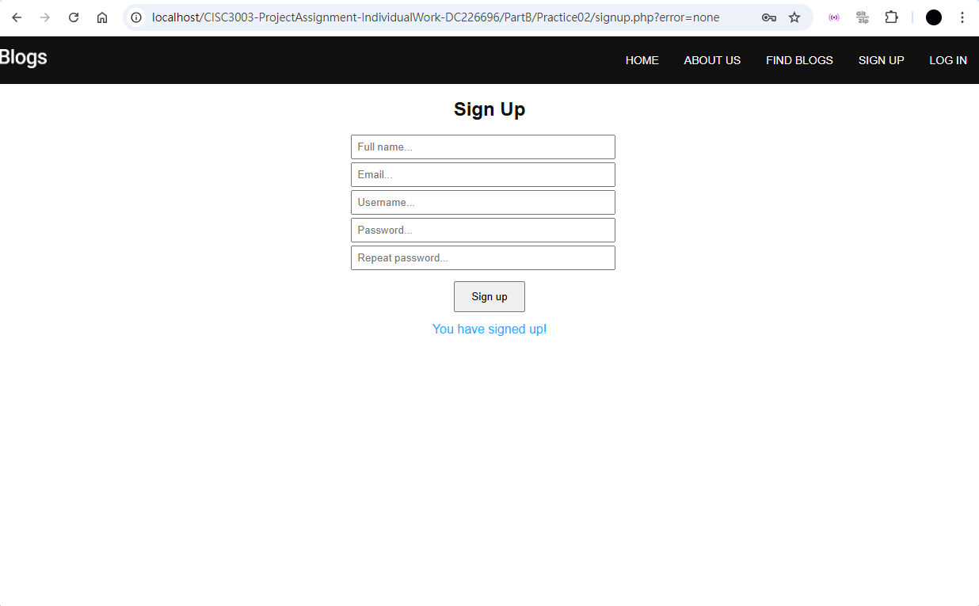
Practice 2 – Sign Up

Slide 28
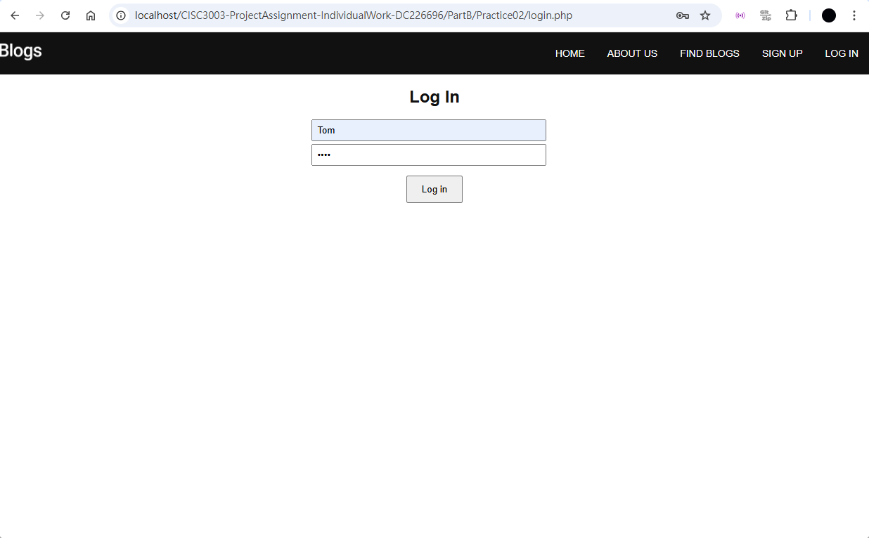
Practice 2 – Login

Slide 29
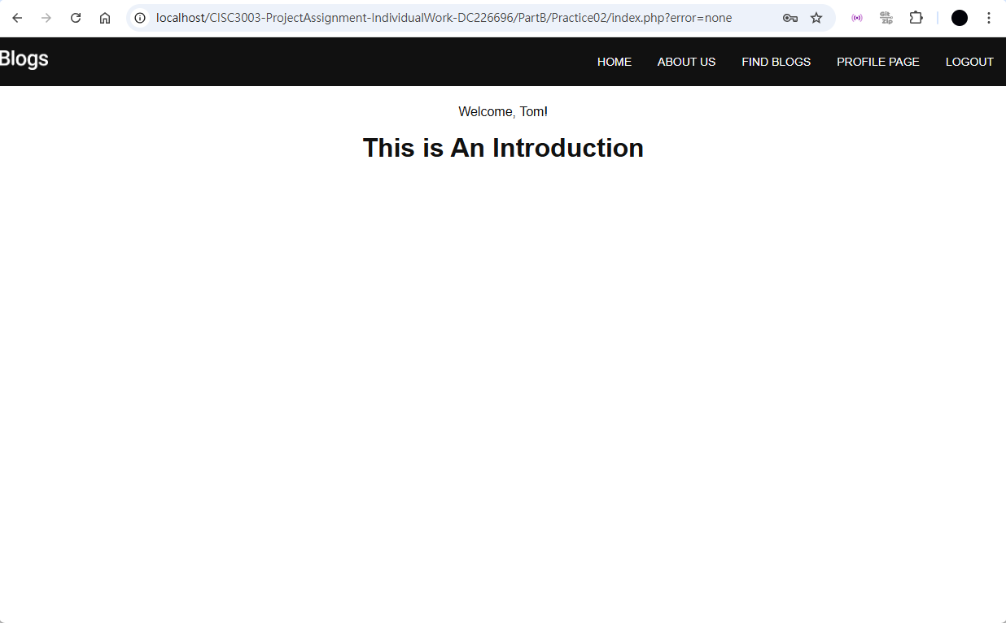
Practice 2 – Logged In

Slide 30
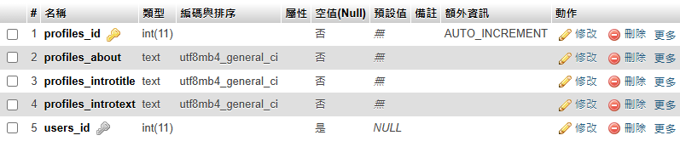
Practice 3 – Database
– users
– profiles

Slide 31
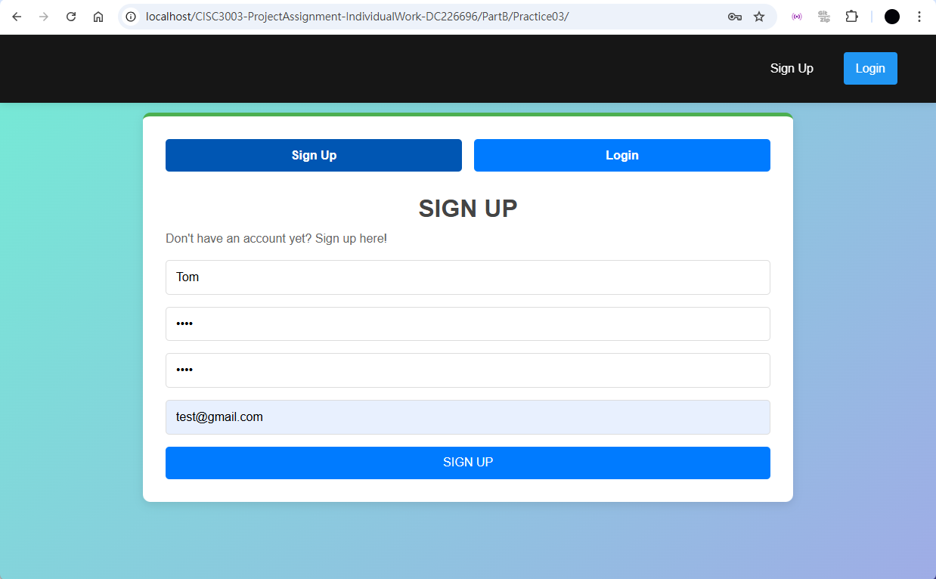
Practice 3 – Sign Up

Slide 32
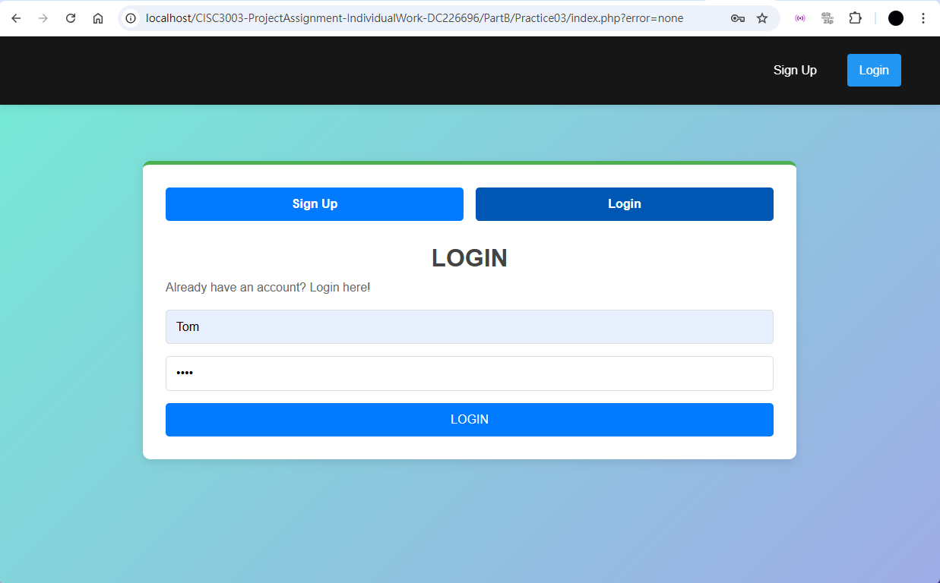
Practice 3 – Login

Slide 33
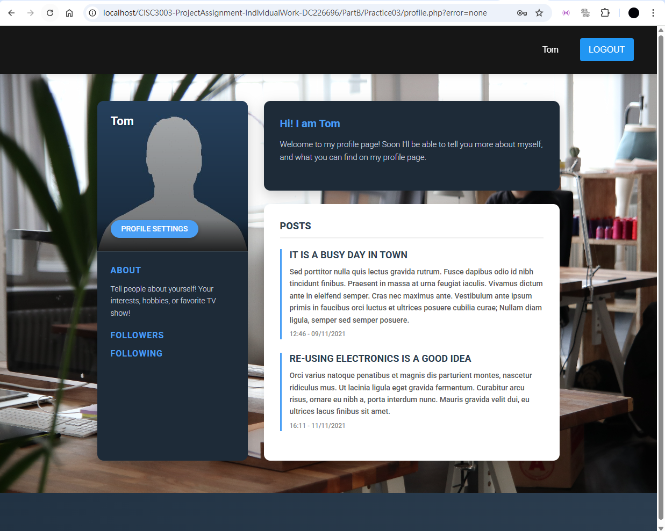
Practice 3 – Profile

Slide 34
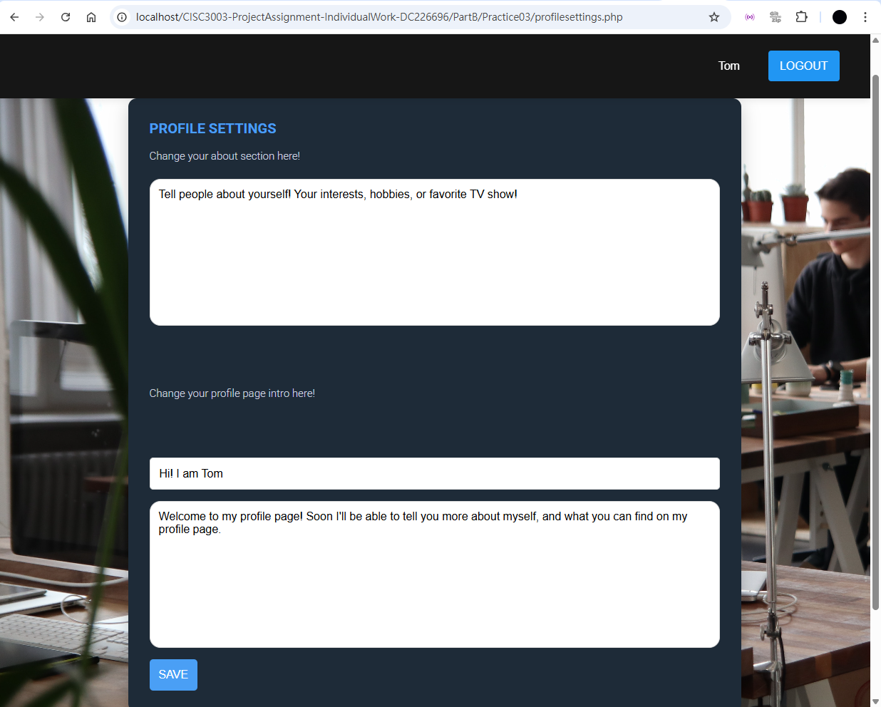
Practice 3 – Profile Settings

Slide 35
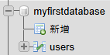
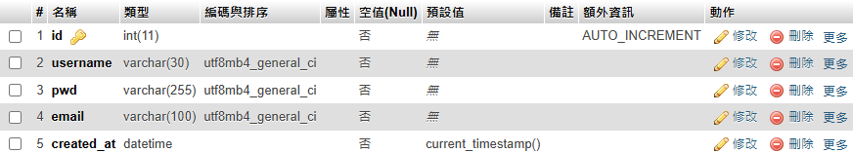
Practice 4 – Database

Slide 36
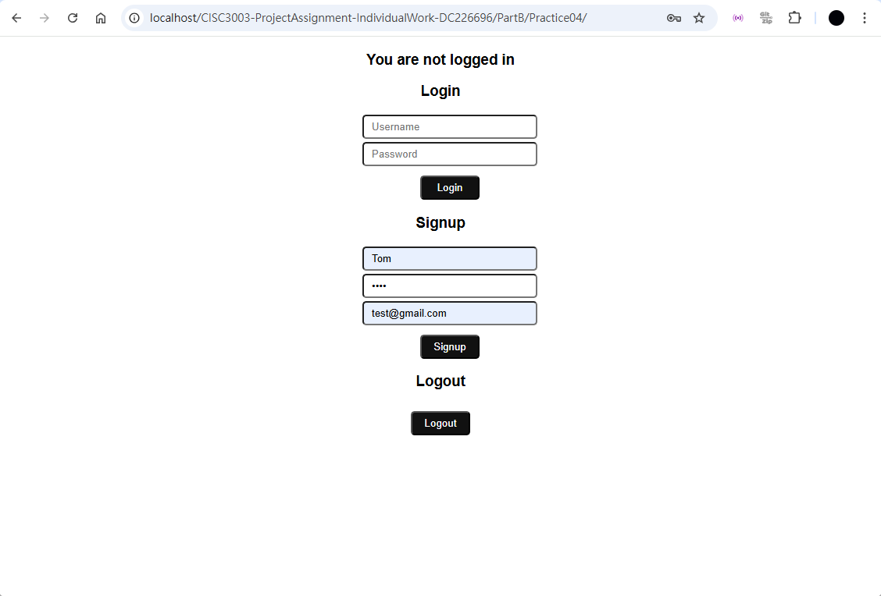
Practice 4 – Sign Up

Slide 37
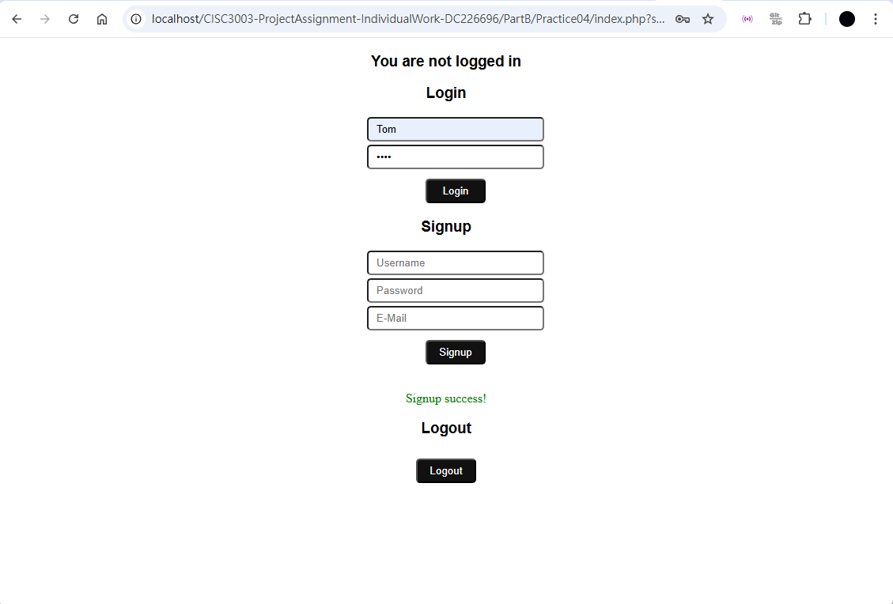
Practice 4 – Login

Slide 38
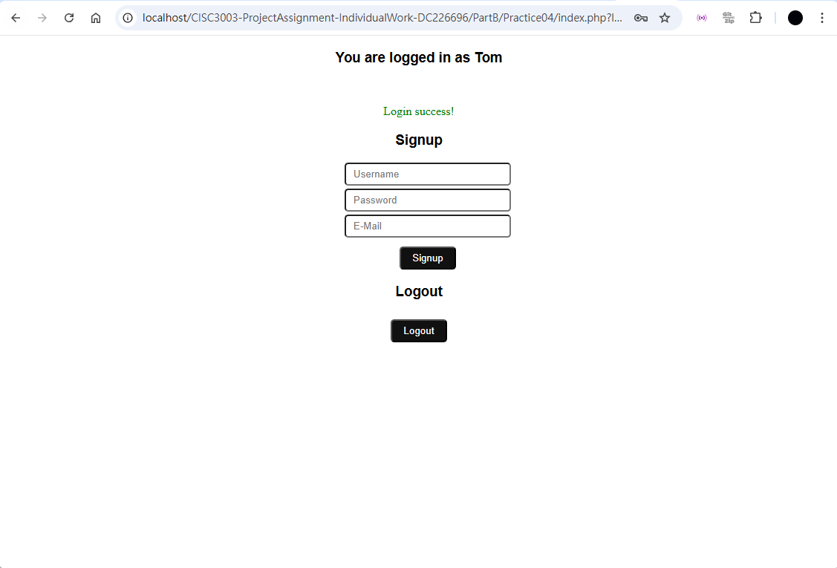
Practice 4 – Logged In

Slide 39
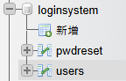
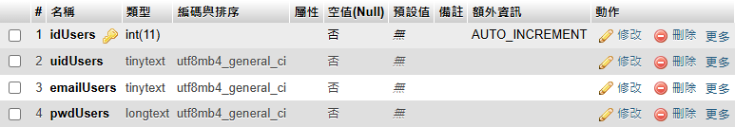
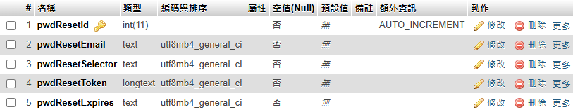
Practice 5 – Database

Slide 40
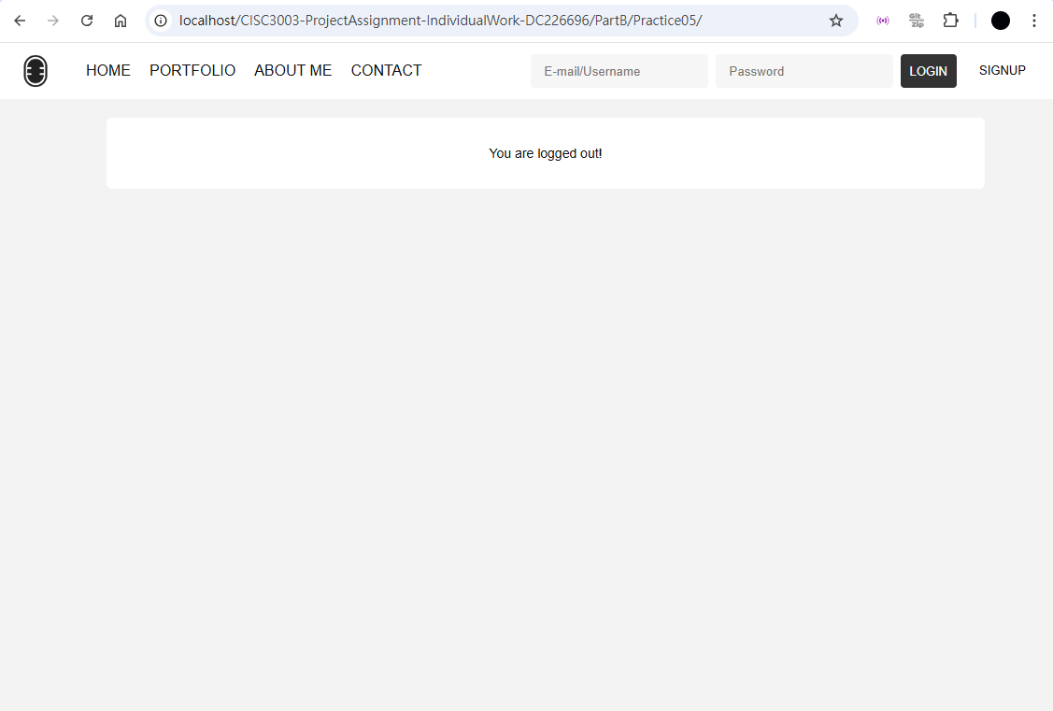
Practice 5 – Home

Slide 41
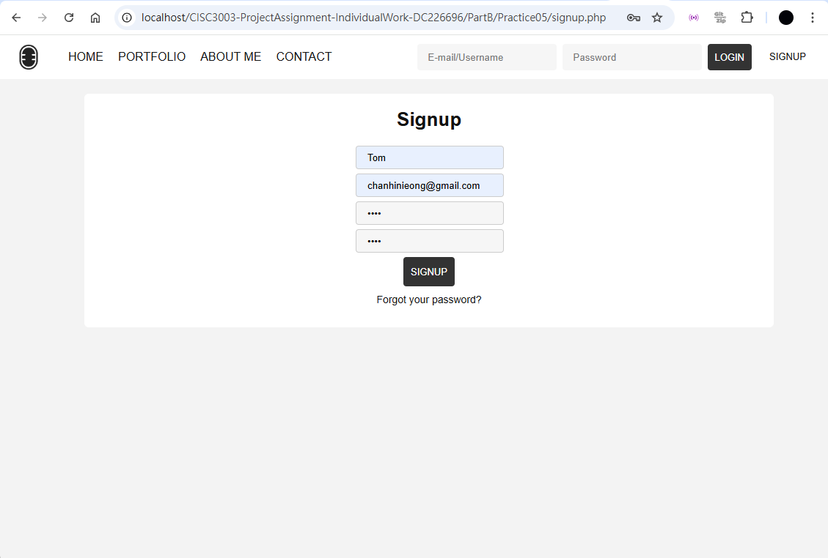
Practice 5 – Sign Up

Slide 42
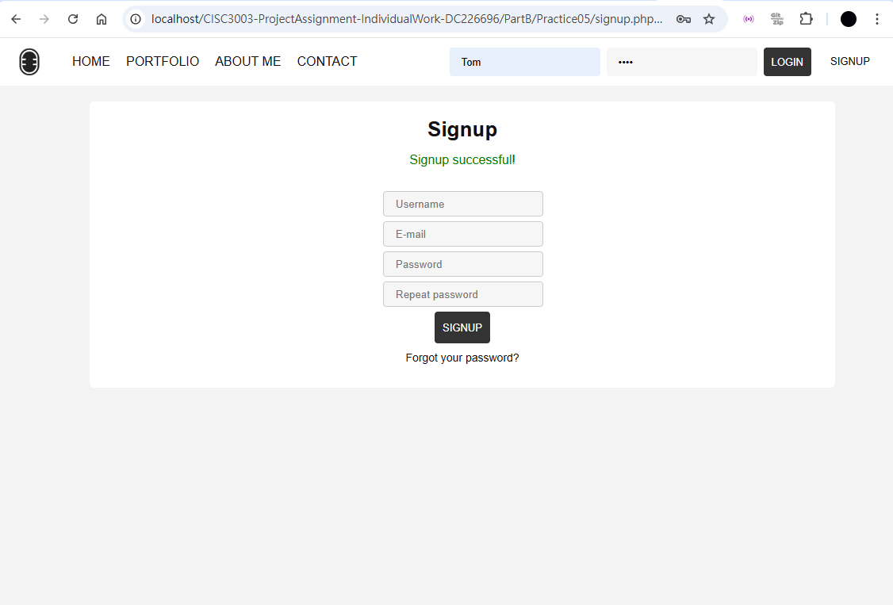
Practice 5 – Login

Slide 43
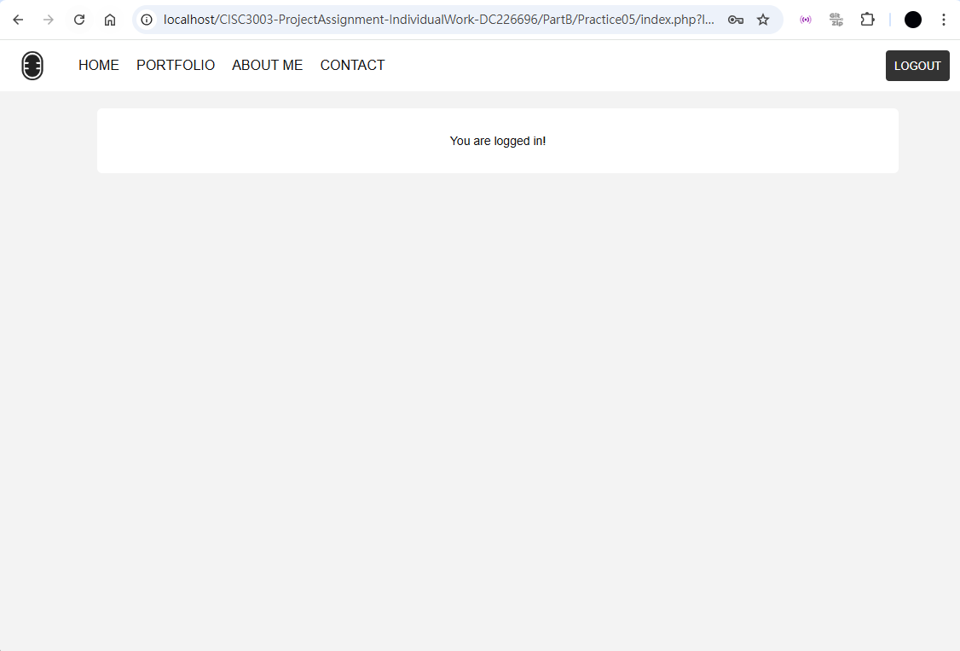
Practice 5 – Logged In

Slide 44
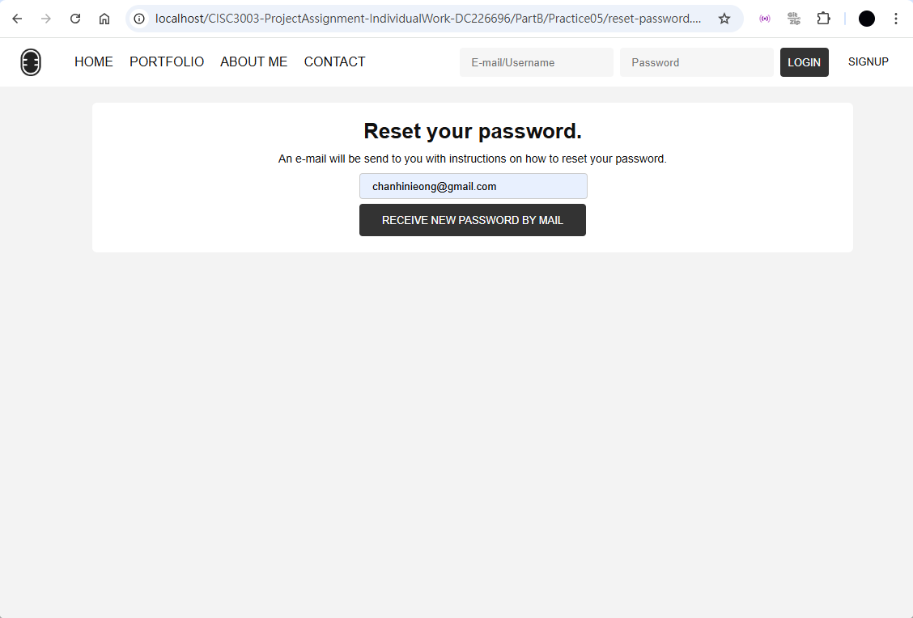
Practice 5 – Reset Password

Slide 45
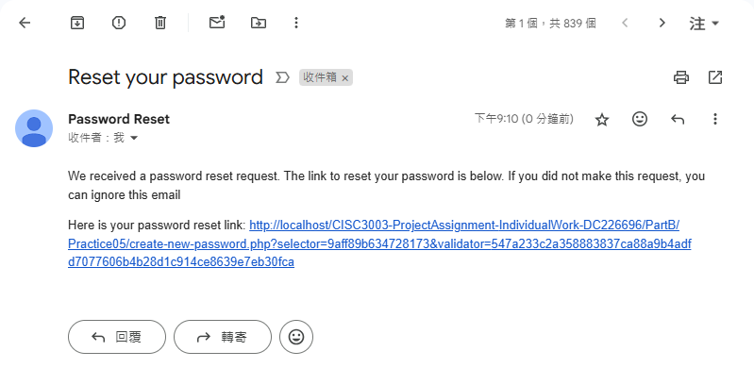
Practice 5 – Receive Email

Slide 46
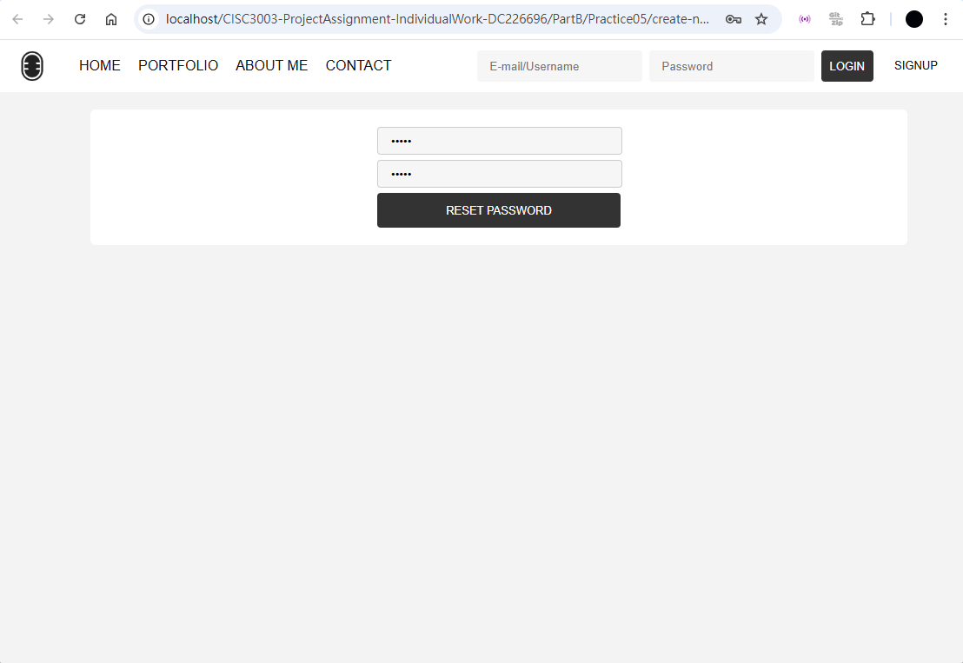
Practice 5 – Create New Password

Slide 47
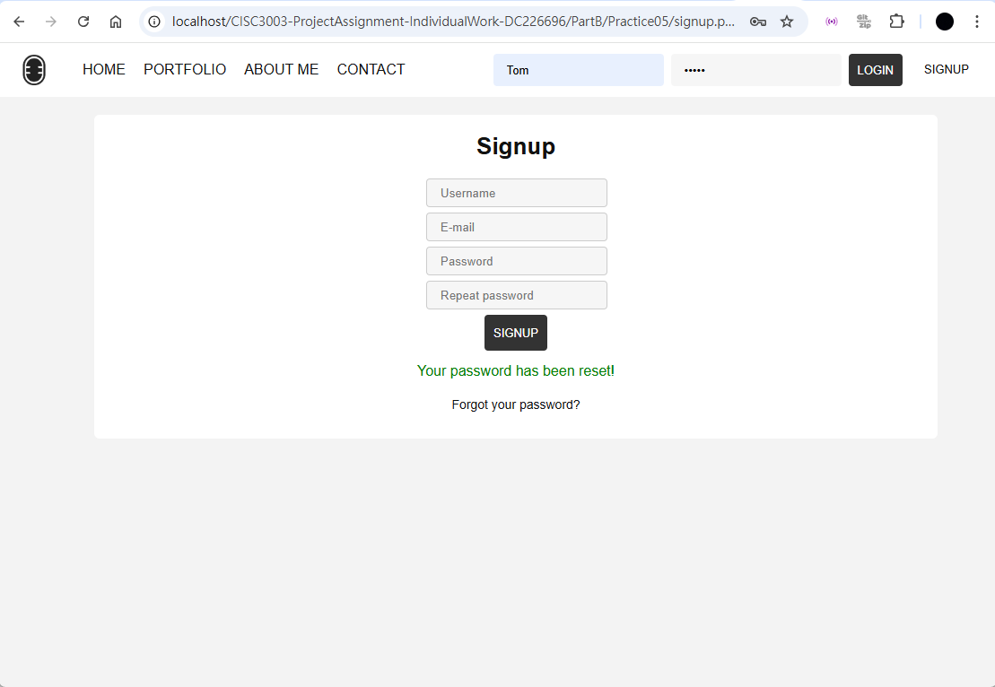
Practice 5 – Login New Password

Slide 48
Thank you!

